Slide 1


Slide 2



“RECORDS MANAGEMENT INFORMATION SYSTEM OF
COMMISSION ON HIGHER EDUCATION – REGION X”
TIPSY BLESS LAGROSAS
Programmer / UI Designer
tlagrosas41997@liceo.edu.ph
VON FRANCIS LA VICTORIA
Analyst / Database Designer
vlavictoria59452@liceo.edu.ph
JEMRY CAIN MAGDUA
Technical Writer
jmagdua18689@liceo.edu.ph
ADVISER : DR. JUN BRIAN TUBONGBANUA

Slide 3
Introduction
The Commission on Higher Education (CHED) is responsible for the supervision and regulation of higher education institutions in the Philippines. As part of its mandate, CHED is required to maintain accurate and up-to-date records of its operations and activities.
This project will also explore the challenges in implementing and maintaining the system, as well as potential areas for improvement. Ultimately, this project aims to contribute to the ongoing development and improvement of the CHED10 Records Management System, as well as to advance the field of records management more broadly.

Slide 4
Statement of the Problem
Unorganized recording keeping system resulted to misplaced of the documents;
Difficulties organizing and searching for records;
Inadequate document tracking; and
Manual generates reports.
Notes:
Unorganized record keeping which result to misplaced documents and higher labour cost of the employee. It can disrupt the flow of the information.

Slide 5
Specific Objectives
Develop a centralize and digitize record management system to minimize the reliance on paper-based documentation and maintain accurate records;
Develop an user friendly search engine of the system;
Create a mechanism for tracking documents; and
Generate reports by category and status of documents.

Slide 6
Preliminary Oral Defense List of Comments June 14, 2023 | Google Meet
No. | Comments
1 | Essential reports must be generated by the system.
2 | Prepare a workflow validation checklist.
3 | Address access control (who sees who documents), backup, data integrity (mechanism)
4 | For the document validation (checker), try using hash. This might be the document fingerprint.
5 | Consider the requirement that government don’t want to host in commercialized drive (like Google Drive). Budget for the authentication drive must be studied. This is to address document leaks such as to how to secure the storage.
6 | Consider the compliance of document handling.
7 | The system must provide a process that checks

Slide 7
Preliminary Oral Defense List of Comments June 14, 2023 | Google Meet
8 | List of different types of documents/records must be identified and documented.
9 | Improve the data dictionary presentation by specifying what data category is being captured.
10 | Be specific in naming tables.
11 | Remove Barangays/Municipalities, these are not necessary.
12 | Study what specific type of document can the client send to CHED.
13 | For the proposed system diagram, change the data flow of the entity Supervisor (or all employees of CHED but with different restrictions in viewing data or information) from Confirmation to send or store. Regional Director can also issue a memo or store information in the system.
14 | System design must be discussed further with Dr. Apag and the research team.

Slide 8
Preliminary Oral Defense Compliance Matrix June 14, 2023 | Google Meet
No. | Comments | Compliance
1 | Essential reports must be generated by the system. | The scope of this study is to assess and enhance the CHED Records Management System in terms of its features, functionalities, and benefits to the organization. This study will cover the processes involved in generating reports and managing records, such as document creation, retrieval, archiving documents, and storage.
2 | Prepare a workflow validation checklist. | Us researchers completed the workflow of validation checklist.

Slide 9
3 | Address access control (who sees who documents), backup, data integrity (mechanism) | Us researchers use the method of connecting to their server and cloud server.
4 | For the document validation (checker), try using hash. This might be the document fingerprint. | Table 6: Doc_Detail (This table contains document detail Information)
5 | Consider the requirement that government don’t want to host in commercialized drive (like Google Drive). Budget for the authentication drive must be studied. This is to address document leaks such as to how to secure the storage. | For more secured storage, we will be using CHED's storage. It will examine the system's access control and security measures to ensure the integrity and confidentiality of records, also we're planning to change from traditional way of paper-based records into a modern paperless record.
Field Name | Type | Size | Value | Description
Doc_ID | VARCHAR | 12 | NOT NULL | (FK) Document ID
Dept_ID | VARCHAR | 12 | NOT NULL | (FK) Department ID
FillCat_ID | VARCHAR | 12 | NOT NULL | (FK) Filling Category ID
Date_Time | DATETIME | 10 | NOT NULL | Date & Time
Description | VARCHAR | 12 | NOT NULL | Description

Slide 10
6 | Consider the compliance of document handling. | Us researcher considered the compliance document handling.
7 | The system must provide a process that checks if a certain document is coming from the system (authentic). | Using QR Code.
8 | List of different types of documents/records must be identified and documented.
CAT_ID
Name
CATEGORY
HAS
CAT_ID
CATEGORY_DETAIL
Outgoing date
Type
Status
Incoming date

Slide 11
9 | Improve the data dictionary presentation by specifying what data category is being captured. | Refer to page 49 to 58.
10 | Be specific in naming tables. | Refer to page 54 & 55.
11 | Remove Barangays/Municipalities, these are not necessary.

Slide 12
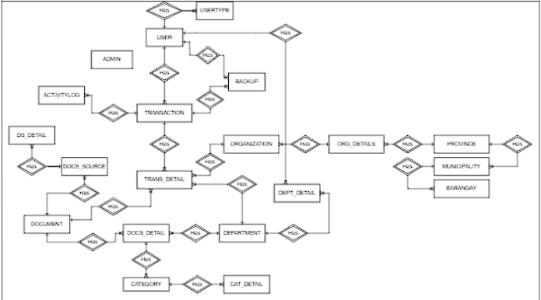
Before:

Slide 13
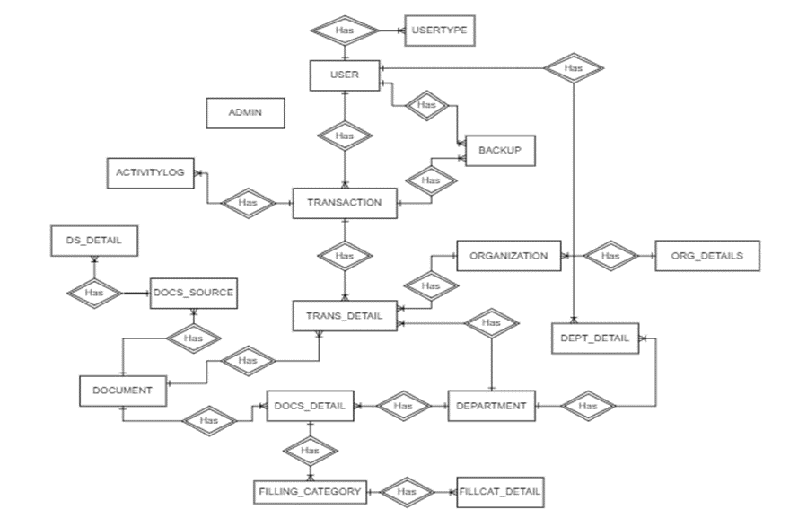
Updated:

Slide 14
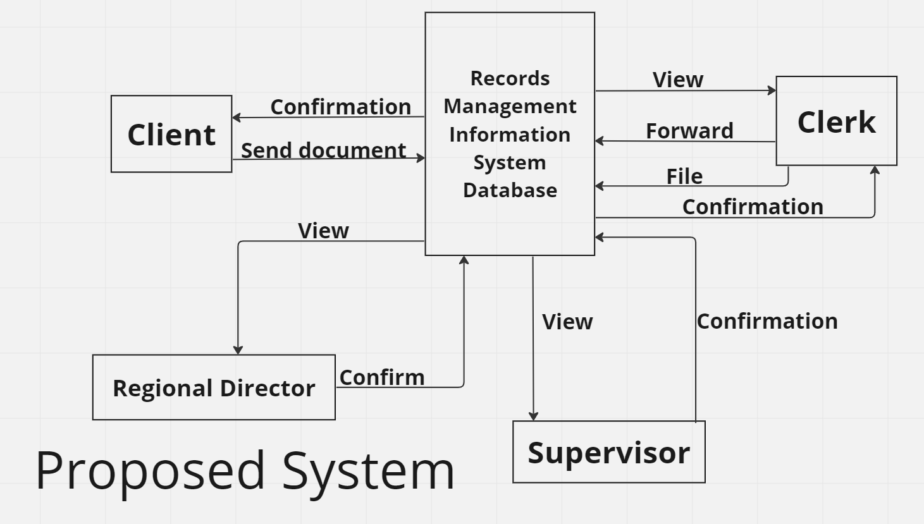
12 | Study what specific type of document can the client send to CHED. | Figure refer to comment number 8.
13 | For the proposed system diagram, change the data flow of the entity Supervisor (or all employees of CHED but with different restrictions in viewing data or information) from Confirmation to send or store. Regional Director can also issue a memo or store information in the system. | Before:

Slide 15
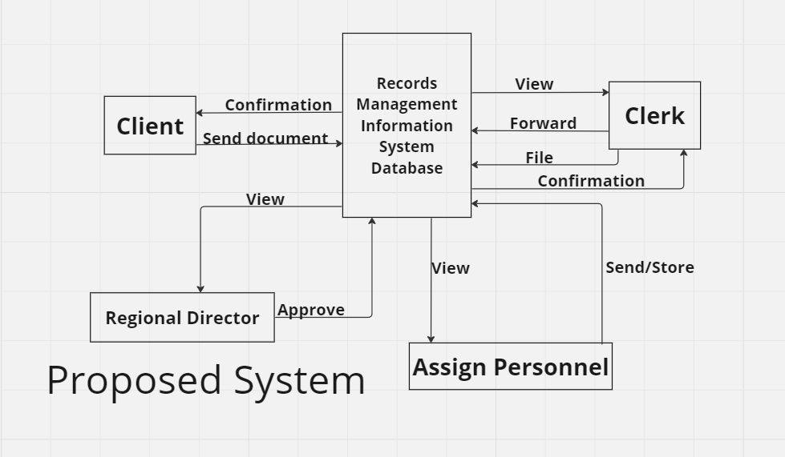
Updated:

Slide 16
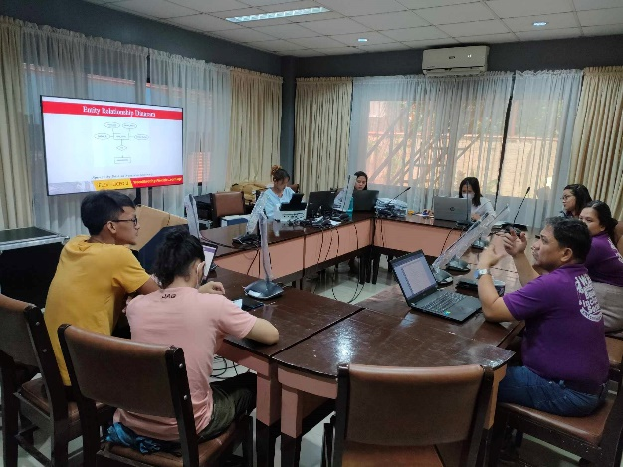
14 | System design must be discussed further with Dr. Apag and the research team. | July 6, 2023.

Slide 17
Thank You!

